Slide 1
Banking Locker Management System Gaurav Malik

Slide 2
Bank Locker Management System is a web-based application that deals with bank lockers that store the valuables things of bank customers. There are different types/Size of locker available, customer can select as per there need or space. All details of lockers are saved in the database. Bank Locker Management System project is developed using Node JS, ExpressJS, MongoDB, PostgreSQL with MicroService architecture.

Slide 3
Flow-Chart :
Micro-Services
API Gateway
(http-proxy-middleware)
Users: 3001
Port: 3000
Admin: 3002
Assigned-Locker: 3003
Locker-Type: 3004

Slide 4
User Module API
Auto Update Using Fetch API on DELETE and POST
Locker API: 3003
Get
User need to be verify first and then can access the locker details
CRUD
User can send request to admin for create new Locker Account using POST
Admin can create locker as per User Request
Locker API: 3004
Admin API
CRUD
Admin have access to perform CRUD on this API

Slide 5
JWT Token
Assigned Locker
Locker Type
USER
ADMIN

Slide 6
Features of User API
Sign-up and Sign-in Feature.
At the time of Sign-Up Password will encrypted with the help of Bcyrpt and keys are encrypted with the help of AES.
A token will generate at the time of sign-In with the help of JWT.
User can see there profile with the help of Sign-In Token.
User can send request to the admin for create a locker.
User can reset password after verifying all keys.

Slide 7
Features of Admin API
Sign-Up and Sign-In Feature.
At the time of Sign-Up Password will encryped with the help of Bcyrpt, no keys required for Sign-Up.
A token will generate at the time of sign-In with the help of JWT.
Admin can use there token to see all the user details and Locker Details.
Admin can check the user request for Locker creation.
Already exist Admin only can create a new Admin with the help of Admin Sign-In token.

Slide 8
Features of Assigned Locker API
Admin can get all locker details and perform CRUD operations on it with the help of Admin Sign-In Token.
User can only get his Details with the help of User Sign-In token and can send request to the Admin to change it if required.
Using Fetch API Locker-Type API will auto update on Add locker and Delete Locker.

Slide 9
Features of Locker-Type API
Admin can get all locker-Type details and perform CRUD operations on it with the help of Admin Sign-In Token.
There is no role for User in this API, only Admin can Perform CRUD if required or to maintain the consistency.
The number of locker will auto update with respect to the size of locker using FETCH.

Slide 10
Micro-Services
Database
Store Password and Keys in Encrypted format
Sign-up/Sign-in
Users
MongoDB
(UserDB)
Send Request to Admin
MongoDB
(AdminDB)
Admin
SignUp/SignIn
POST Locker
Assigned-Locker
MongoDB
(Assigned-Locker)
FETCH_API
Postgre-Sql
(LockerType)
Locker-Type

Slide 11
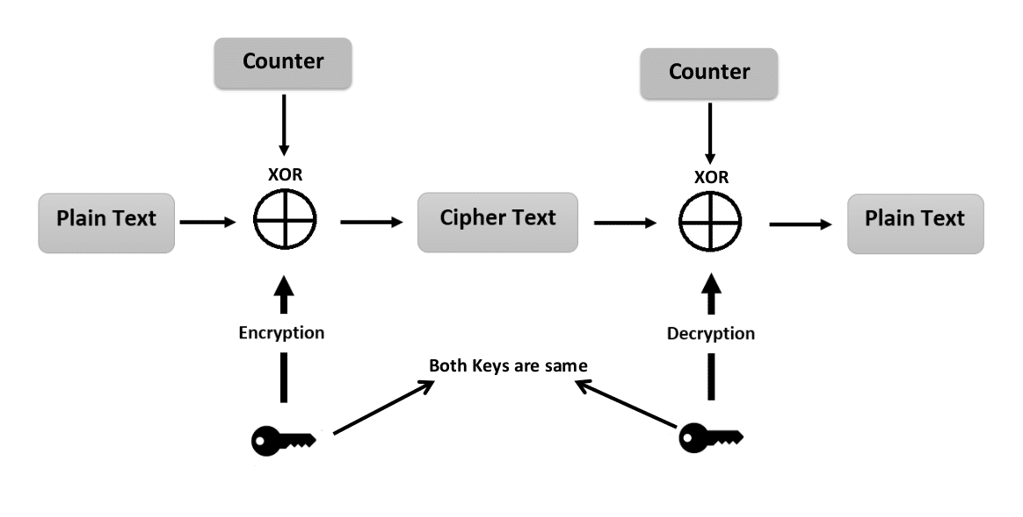
Password encryption (AES)

Slide 12
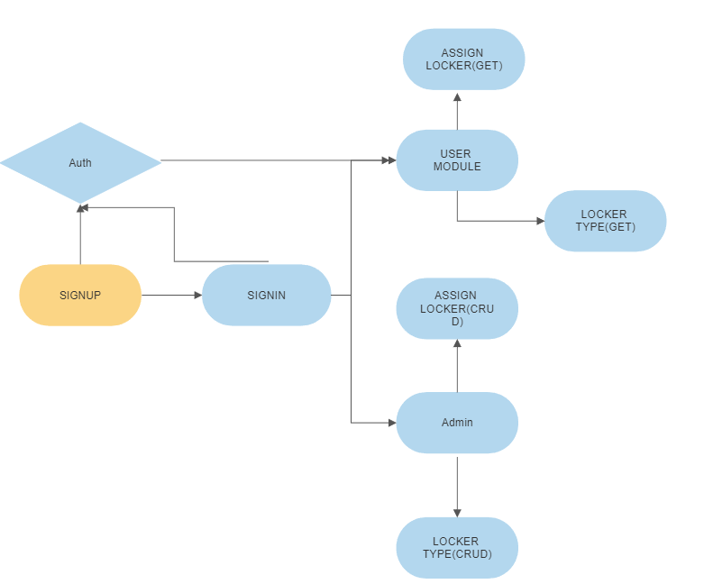
Middleware
Authorise using JWT Token

Slide 13









Slide 14
Thankyou

